Slide 1
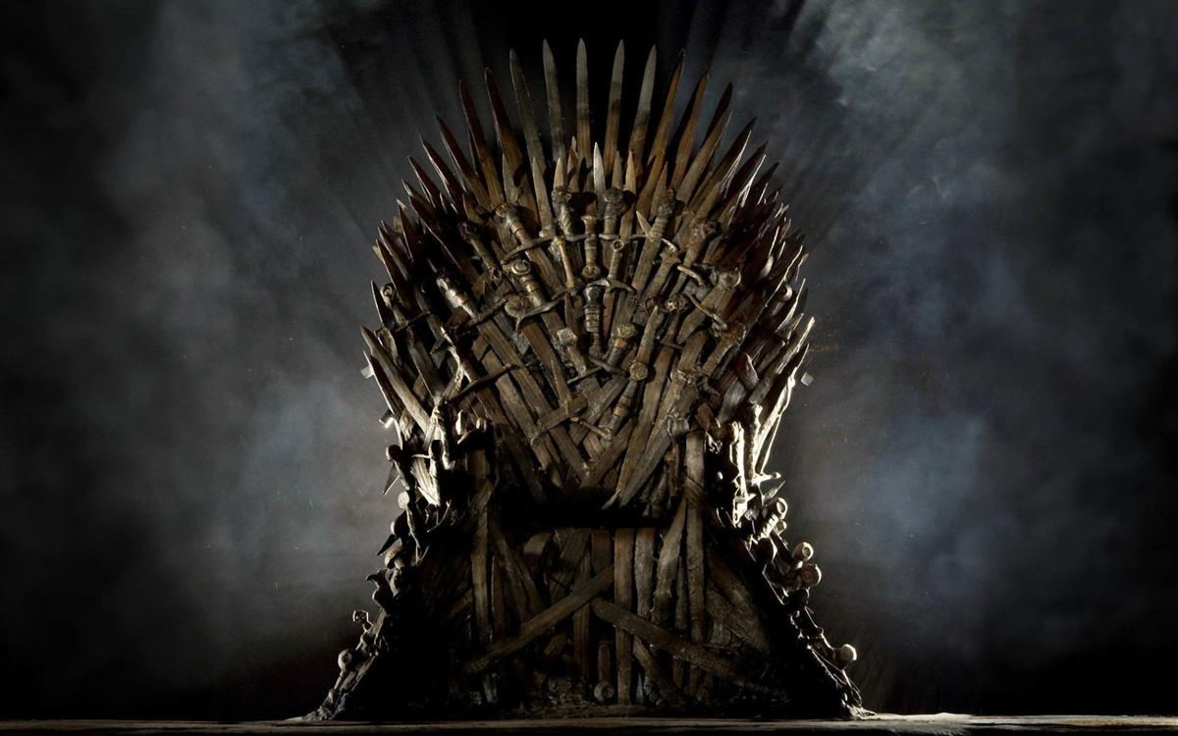
Exploratory Data Analysis of A Game of Thrones Character Deaths
Samantha Beard DSC 530 Final Project

Slide 2
Scenario:
If you’ve seen the show or read the books, you know that there are thousands of deaths throughout the series of A Game of Thrones, and that the series is full of magic. However, what if magical methods/weapons were removed from the data? This would include dragons and White Walkers, as well as weapons that could not be forged without magic, such as ice swords.
Who would be the most vicious killer in all of Westeros?
How many deaths would have still happened?
What is the most used weapon?

Slide 3

Hypotheses:
Daenerys will lose the largest number of deaths associated with her name.
Cersei will have the most deaths on her hands.
Sword will be the most used weapon
House of Lannister will have been responsible for more deaths than House of Stark and House of Targaryen

Slide 4
What data will be considered?
Name – person who died
Allegiance – who the person that died is aligned with
Season – season the death took place
Episode – episode number in the season
Killer – who is held responsible for the death
Killers House – who is the killer aligned with
Location – where did the death take place
Method – weapon used
Magical – True or False

Slide 5
These key words for the method of death will indicate if the death was magical.
Dragon
Demon
Ice
Magic
moon

Slide 6
1227
non-magical
997
magical

